Slide 1
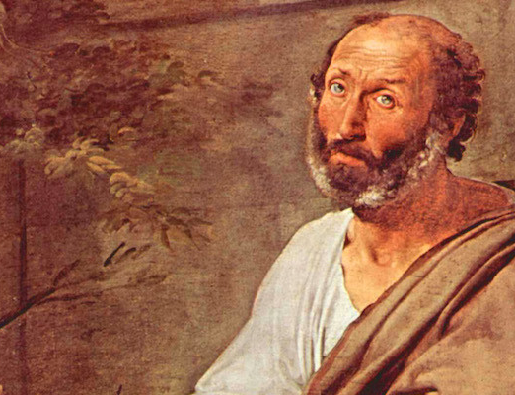
Aristotle’s
Virtue
Ethics
Theology 136

Slide 2
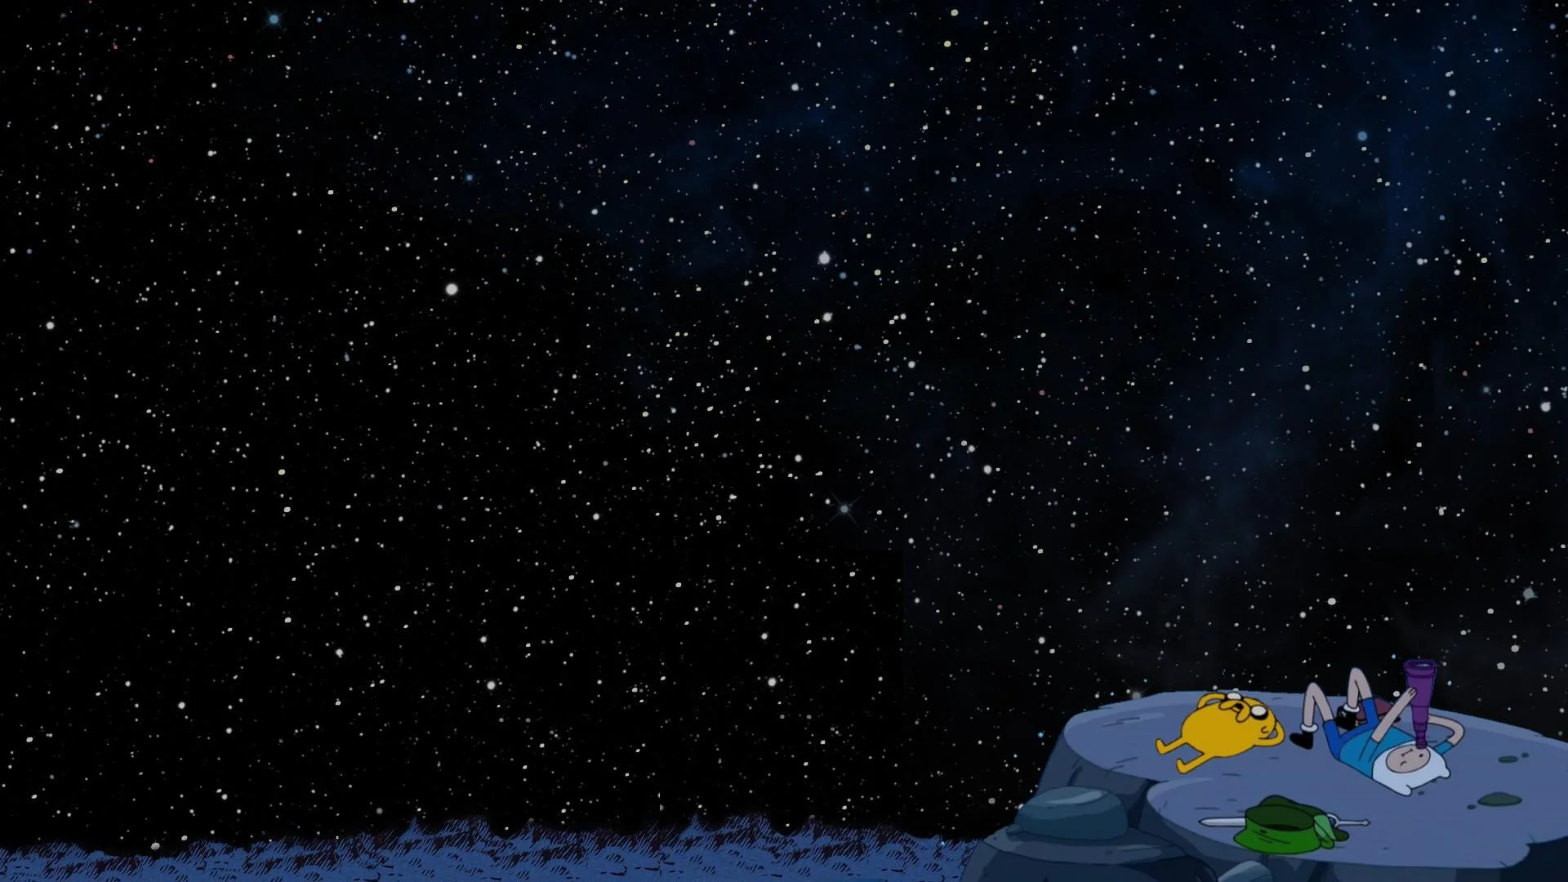
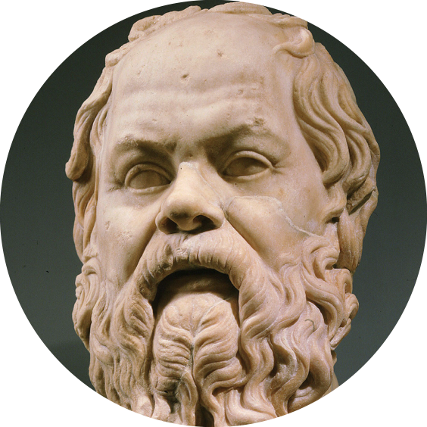
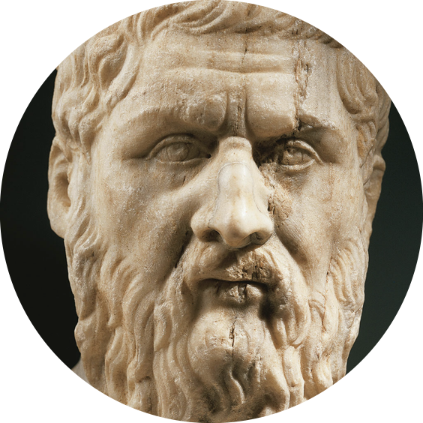
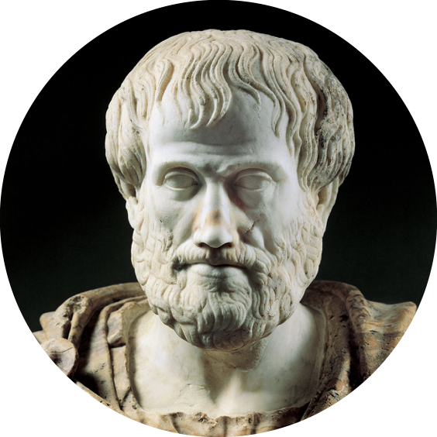
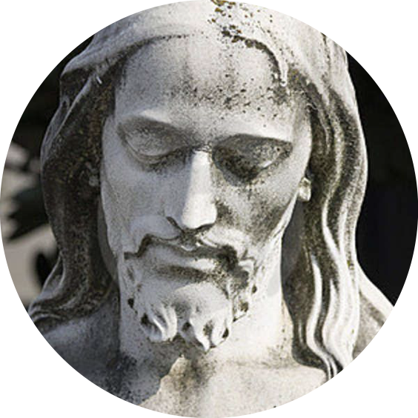
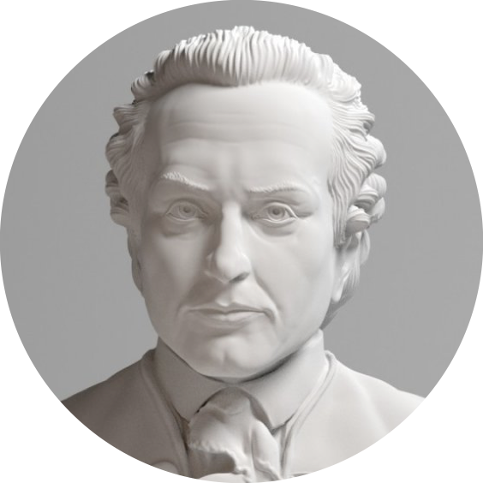
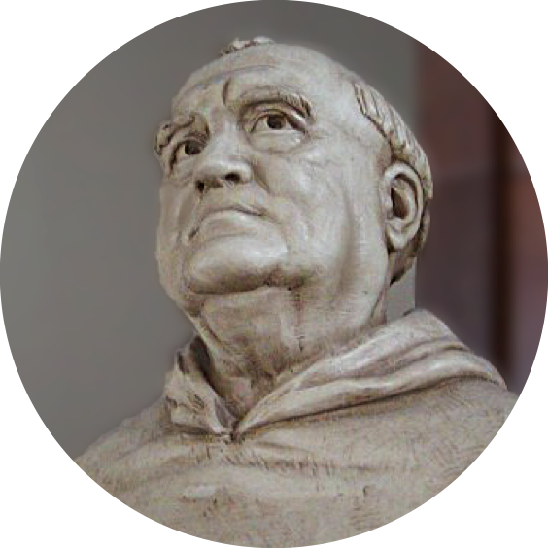
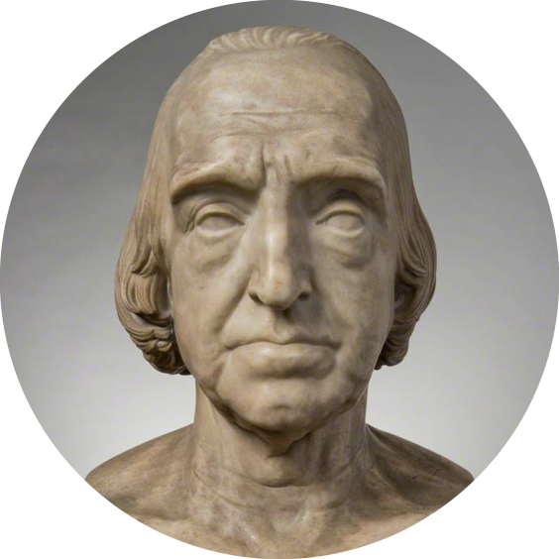
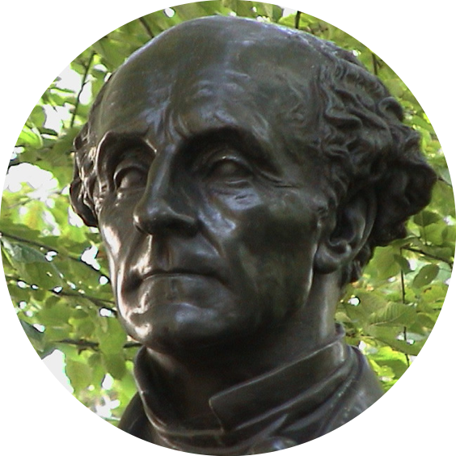
Timeline of the Moral Philosophies
Socrates
(470-399 BC)
Christianity
Plato
(429-347 BC)
Kant
(1724-1804)
Aristotle
(384-322 BC)
Thomas
Aquinas
Jeremy
Bentham
(1748-1832)
John
Mill
(1806-1873)

Slide 3
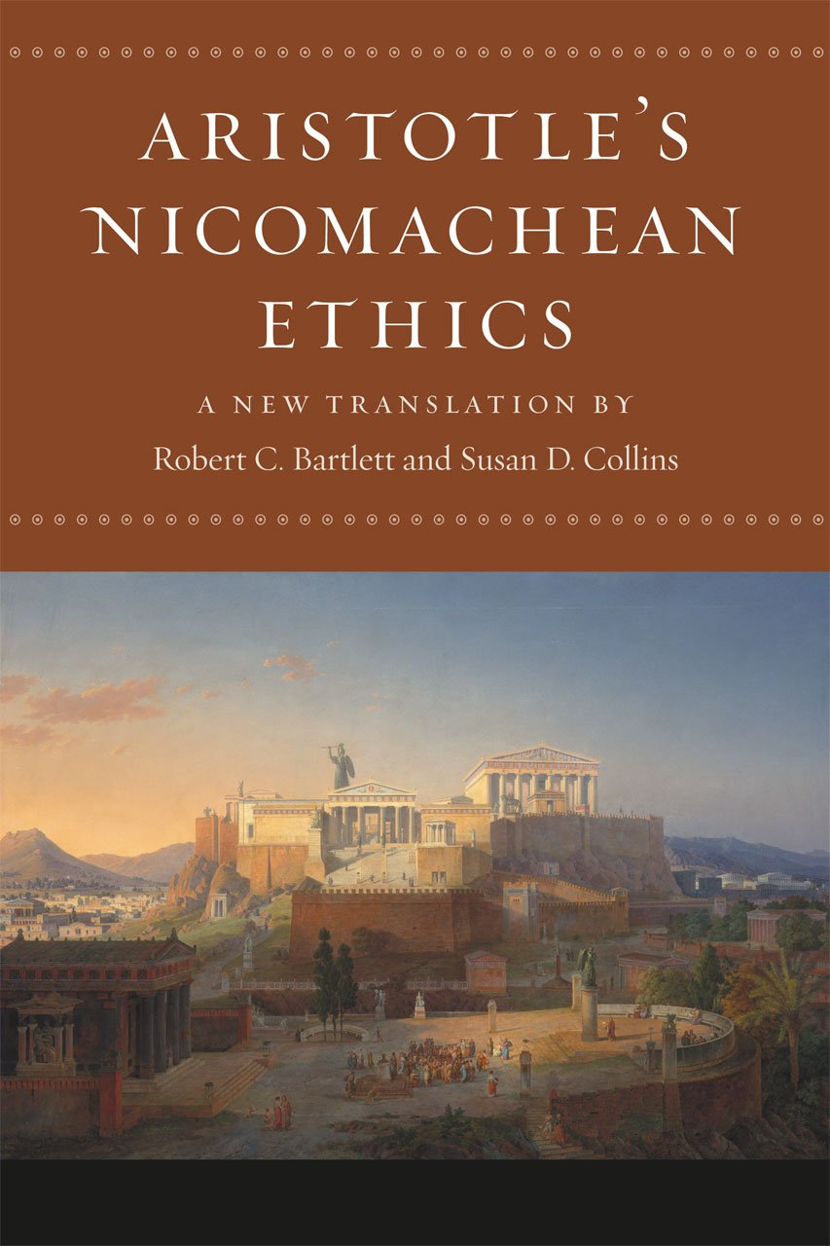
Teleology & Eudaimonia (p.23-24)
For Aristotle, everything in the world has a purpose for which it was made, or a goal towards which it strove. (ex. Eye, Acorns, etc.)
“Teleology” - the explanation of things in terms of the purpose they serve rather than of the cause by which they arise.
Things may sometimes not achieve their “telos” due to disease or accident.
Human beings also have a “telos,” and this goal is “eudaimonia.”
“Eudaimonia” is happiness or welfare; human flourishing or prosperity and blessedness.
Happiness is the purpose for which man is made and is the ultimate reason we do everything.

Slide 4
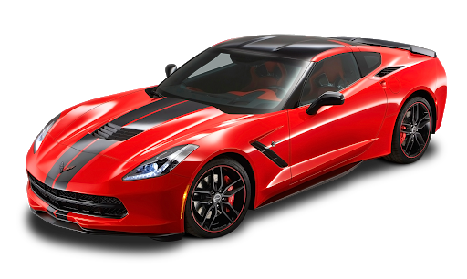
But what exactly leads to happiness and is it the same for everyone?
HAPPINESS IS
OBJECTIVE (p.25)
Aristotle did not mean that all people should dress a certain way or have a certain job… [but] that a person must live in a certain way.
A person’s character must be formed in a certain way to be truly happy.
Happiness includes objective elements - things that are true for everyone independently of anyone’s opinion of them.
HAPPINESS IS
SUBJECTIVE (p.24)
Everyone has their own path to happiness.
What makes one person happy is not necessarily the same for the other.
The Sports Car analogy (p.25)

Slide 5

Happiness & Virtue (p.25-26)
There are certain things in life that we are free to choose, but there are other things that must be done a certain way.
People must live a certain way, and that way is the way of VIRTUE.
Virtue is a necessary condition for happiness. True happiness is not possible without it.
Even if an evil person says they are happy, it is not true happiness.
By making bad choices in life, they have become diseased and corrupted and are unable to achieve their telos.

Slide 6

“If I believe I’m happy, aren’t I happy?” (p.26-27)
“No one would choose to live with the intellect of a child.” (Story of the Young Boy and the Banana Split, p.26)
The child believes he is happy because of his limited experience.
A child’s conception of happiness lacks the proper perspective of happiness and pales in comparison to an adult.
A vicious man or self-absorbed person is somewhat like a child --- incapable knowing true happiness because of what they believe.
True happiness again, comes from a virtuous character, not from a selfish and egoistic belief.

Slide 7
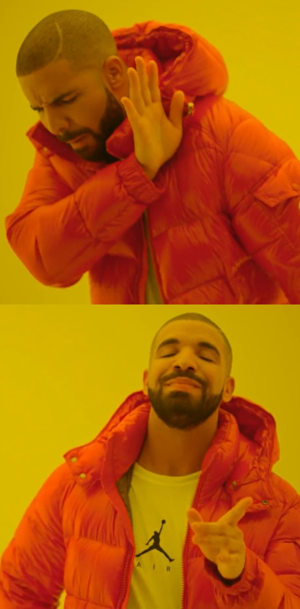
Aristotle vs. Relativism (p.27)
Relativism is the philosophy that states that there are no moral rules that apply to all cultures or all people.
Although happiness may sound subjective, Aristotle maintains the is objectivity to human nature.
“Aristotle [asserts] that all human beings share the same basic nature and that ALL human beings must live lives of virtue in order to achieve their goal or telos.”
Therefore, relativism is flawed and Aristotle rejects it as a moral philosophy

Slide 8


On Character (p.28)
Parts of a Human Being (p.28)
People have set characters - stable sets of attitudes, opinions, and dispositions that result in stable patterns or ways of acting and reacting.
We are drawn to people with appealing character or personality.
Each person has two basic parts:
Rational - reasoning, thinking, deliberating and judges right and wrong (what makes us different from animals)
Non-Rational (with two parts as well):
Appetitive - desires and emotions (what we share with animals)
Vegetative - involuntary functions (like growth, breathing, heartbeat, etc.) - no role to morality/ethics

Slide 9

Formation of Virtues and Character (p.29-30)
The rational part should control the appetitive part with discipline and the formation of good habits.
The virtues or good habits need to be learned and repeated so we become habituated to the activity.
If we train ourselves in a good fashion, we will create good states of character.
By repeating certain types of behavior, we can change how we feel or react to certain situations.
“When people have been taught or habituated both to judge with their rational part the appropriate way to behave or respond in a certain situation and to feel or desire in the appropriate way, then they have acquired virtue.”
But virtue or good habits need to be consistently exercised, otherwise they may become lax and be corrupted with bad habits.

Slide 10

The Four Major Character Types (p.30-32)
1 Continent / Enduring
People who use their reason and struggles to ward off the desire for too much pleasure and can withstand fear or painful emotions in difficult situations.
2 Incontinent / Soft
People who struggle with their appetitive part and lose their battles to their desires and emotions.
Incontinence is a state of character marked by weakness towards pleasure; Softness by an aversion to pain.

Slide 11


3 Virtuous
People who do not struggle because their appetites are in harmony with their rational part.
Able to show the appropriate mix of friendliness and self-respect without any struggle.
Difference with continent or enduring persons (p.31)
Difference lies in how they do the right thing
4 Self-Indulgent / Vicious
Corrupted by continuous bad action, the rational part can no longer judge right from wrong.
They do not struggle with emotions and desires, but actively does the wrong thing without much remorse.
These characters are incorrigible and often beyond help.

Slide 12
Summary of the Four Major Character Types (p.32)
Character Type | Is Reason able to judge right from wrong? | Are Appetites in line with Reason? | Does the moral agent do the right thing?
Virtuous | Yes | Yes (no struggle) | Yes
Continent / Enduring | Yes | No | Yes
Incontinent / Soft | Yes | No | No
Vicious / Self-Indulgent | No | Yes (no struggle) | No

Slide 13
Another Summary of Character Types
VICIOUS
CHARACTER
Does NOT know what’s right from wrong (irrational). Reason and appetites are in harmony (no remorse/regrets) Chooses to do the wrong thing.
The Vicious man is the result of the poor habits of the Incontinent man. After enough times of their contrary desires thwarting their proper choices their reason becomes undermined by improper emotion.
Or, since their conscience is constantly pricked by their moral failing they decide, unconsciously, to correct the issue by rejecting morality.
INCONTINENT
CHARACTER
Knows what’s right from wrong (rational). Reason loses out to appetites (desires/wrong emotion) Chooses to do the wrong thing.
The Incontinent man is very similar to the Continent man but lacks self-mastery.
The man who wishes to be a whistleblower but does not act for financial reasons (from loss of position); the bystander that knows they should stop the fight but fails to do so from cowardice; etc.
CONTINENT
CHARACTER
Knows what’s right from wrong (rational). Reason wins over appetites (desires/wrong emotion) Chooses to do the right thing.
Continent man succeeds by self-mastery.
His reason understands the moral good; he chooses to act appropriately; and he does act appropriately.
But he suffers from contrary desires - he wants to run away almost more than to fight; he wants to indulge his lust rather than remain chaste; he wants to be stingy rather than pay the appropriate amount; etc.
VIRTUOUS
CHARACTER
Knows what’s right from wrong (rational). Reason and appetites are in harmony (proper desires & emotions) Chooses to do the right thing.
Being Virtuous is a state (character), not a potential or tendency.
A Virtuous man understands what is right, chooses to do the virtuous thing, acts properly upon this choice, and does not have 'contrary desires'.

Slide 14

Why Virtuous People are the Happiest (p.32-33)
Vicious (or wicked) people will most probably be friendless.
Or they may be forced to seek out friends in order to avoid themselves, for they have nothing admirable about them.
Incontinent people are doomed to lives of anguish. They suffer great emotional or psychological pain.
Virtuous people live a life of harmony; their reason and passion act in unison.
This is therefore, the moral life for Aristotle.

Slide 15

Virtue: The Golden Mean (pp.33-34)
How do virtuous people choose the right thing to do? How does one become virtuous?
Recall: the virtuous person is able to judge with his rational part the appropriate way to behave or respond in a certain situation and to feel or desire in the appropriate way.
The virtuous person strives for the middle course --- the “golden mean.”
For nearly every passion and action, the virtuous person will try to steer an intermediate or mean course between two extremes.
The extremes are called vices:
Excess - too much
Deficiency - too little
“For men are good in but one way, but bad in many.”

Slide 16
Chart of Values & Rules (p.34)
ACTIVITY | VICE (Excess) | VIRTUE (Mean) | VICE (Deficit)
Reacting to injustice | Irascibility | Anger | Inirascibility
Claiming honors | Vanity | Proper Pride | Humility
Being amusing | Buffoonery | Ready-wittedness | Boorishness
Fearing danger | Cowardice | Courage | Foolhardiness
Giving money | Prodigality | Liberality | Illiberality
Eating, Drinking and desiring sex | Gluttony, Self-indulgence | Temperance | Insensitivity
Interacting socially | Obsequiousness | Proper Friendliness | Sulkiness

Slide 17
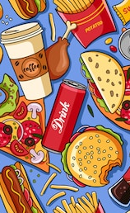
The Mean is Relative to each Person (p.34)
The middle / mean is relative to each person.
Ex: Eating & Exercise
The diet for a 6’ man would be excessive for a 5’2” woman
A healthy exercise regimen for a teenager might kill an elderly man.
However, there is still an objective right or wrong for each person.
All people have an objectively right for them, even though the objective range is relative to each person.

Slide 18
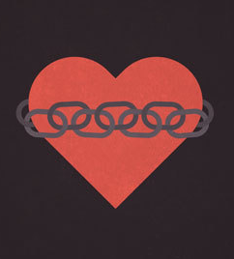
Exceptions to the Rule (p.35)
The “golden mean of moderation” does not hold for all actions.
There are some actions that are essentially evil and do not have excesses or deficiencies.
Ex. spite, shamelessness, envy, adultery, theft, murder
These are all, by nature, disordered.

Slide 19
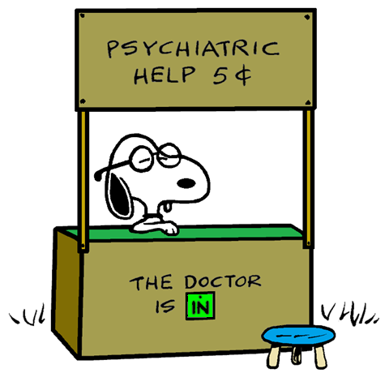
Practical Advice on How
to Find the Mean (pp.35-38)
Most people are not virtuous but are either continent / enduring or incontinent / soft.
Some advice on becoming virtuous:
The virtuous person is the measure
Other guidelines:
Avoid the extreme that is more opposed to the mean
Know yourself
Always be wary of pleasure, for all things, it is most likely to lead you astray
The bent stick remedy

Slide 20

E1. The Virtuous Person is the Measure
Everyone’s knowledge of virtue is acquired by observing virtuous people.
Continent / Incontinent people who wish to be virtuous should model their behavior on that of virtuous people.
Virtuous people should help continent / incontinent people understand their situation.
Sometimes the continent / incontinent may believe they are in the mean / middle, but may need help to see things in the proper perspective.

Slide 21
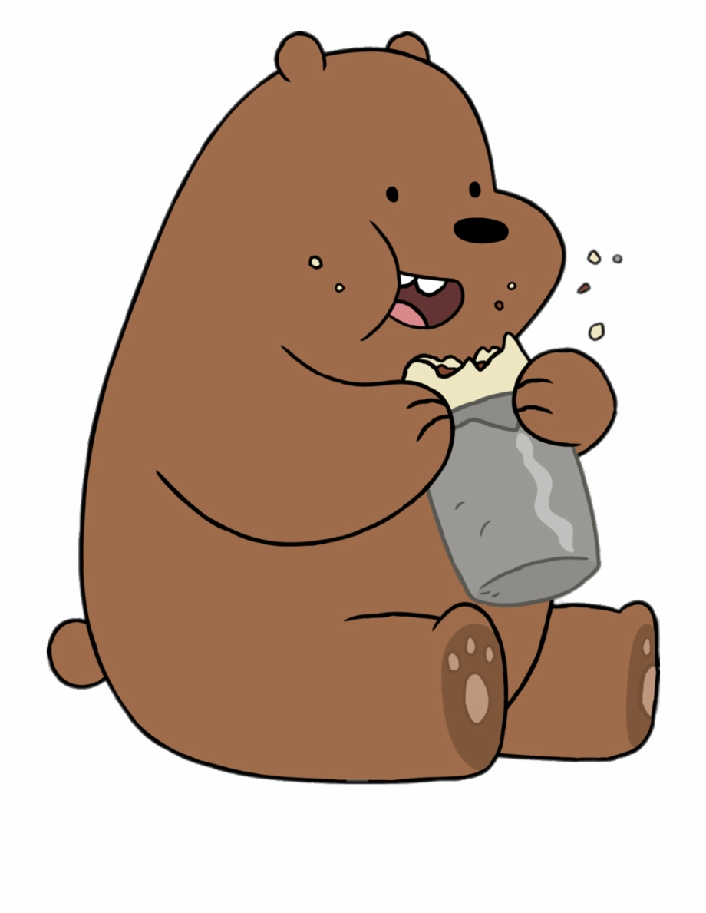
E2. Avoid the extreme that is
more opposed to the mean
Other Guidelines
Each virtue is flanked by two vices, but usually one of these vices is much more likely to ensnare the moral agent.
Ex. Eating / Drinking / Sex
More people are likely to fall into self-indulgence or gluttony than insensitivity
Ex. Fearing Danger
More people are likely to fall into cowardice rather than foolhardiness or brazenness.

Slide 22

E3. Know Yourself
E4. Always be wary of Pleasure
Other Guidelines
Know yourself and as a result, learn to avoid those vices to which you are more particularly prone.
Nothing wrong with some pleasure, but the total pursuit of pleasure in itself is problematic.
The pursuit of pleasure is likened to the pursuit of a cat.
The more you pursue it, the more you become enslaved to it; you lose control
But by pursuing the middle ground, you enjoy life, even though you are not pursuing pleasure directly.

Slide 23

E5. The Bent Stick remedy
Other Guidelines
This involves people acting in the extreme opposite until a person finds the virtuous mean.
Aristotle recommends that a person should strain every nerve to reverse his/her behavior completely.

Slide 24
Virtue Ethics vs. Christian Ethics (pp.38-42)
AGREEMENTS
Both emphasize human happiness or flourishing.
God has implanted in every human being a desire for happiness in union with God.
Virtue is characterized in Scripture and other Christian writings.
“Human virtues are firm attitudes, stable dispositions, habitual perfections of intellect and will govern our actions… passions and guide our conduct…”
DISAGREEMENTS
Some Christian virtues are not shared by Aristotle
Ex. Faith, hope, charity, fear of the Lord, humility
Aristotle seems to have little concern for the welfare of those outside one’s circle of friends, the poor or the marginalized
Aristotle existed before Christianity. Even though there are disagreements, Aristotle has a profound and positive effect on Christian thought.

